Slide 1

RELAX OASIS

Slide 2

MQTT
ASYNCHRONOUS COMMUNICATION PARADIGM
BASED ON TOPICS
LIGHTWEIGHT

Slide 3
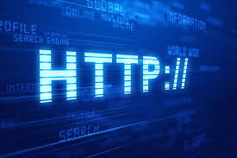

REST
SYNCHRONOUS COMMUNICATION PARADIGM
Resource-Oriented
Stateless Interactions

Slide 4
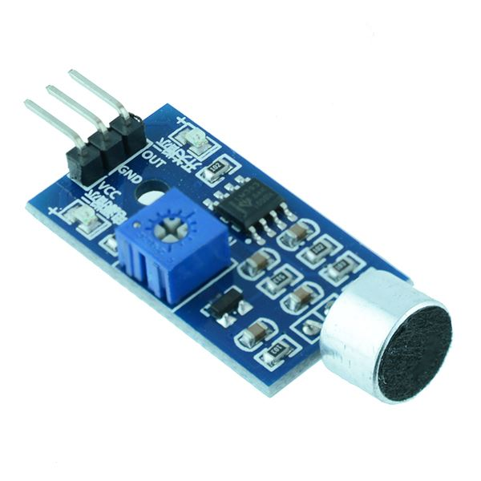
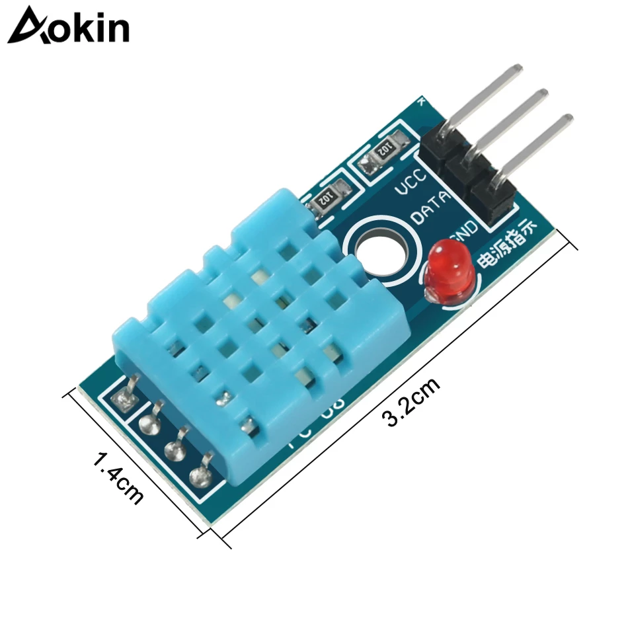
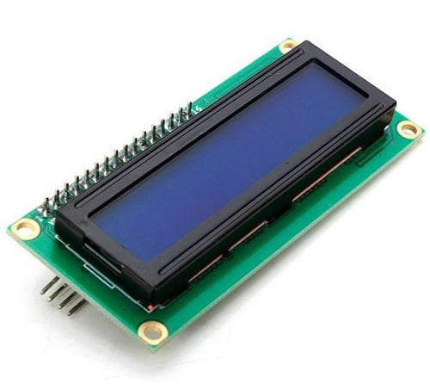
RELAX ROOM IS A PROPOSAL TO MAKE A RELAXING PLACE WELCOMING AND COMFORTABLE IN A SMART WAY
SENSORS and SIMULATED SENSORS
NOISE and LIGHT TEMPERATURE and HUMIDITY LCD

Slide 5
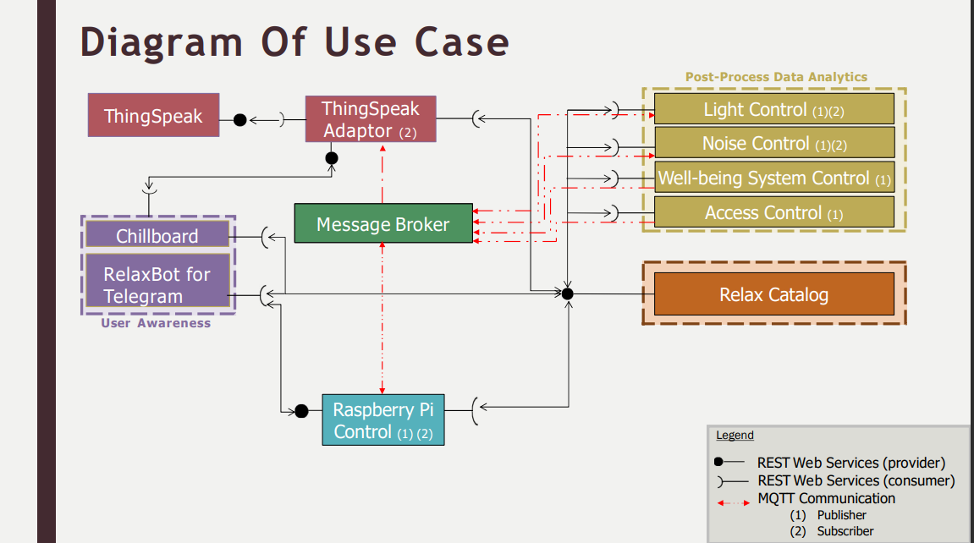
PROJECT PROPOSAL - BEFORE

Slide 6
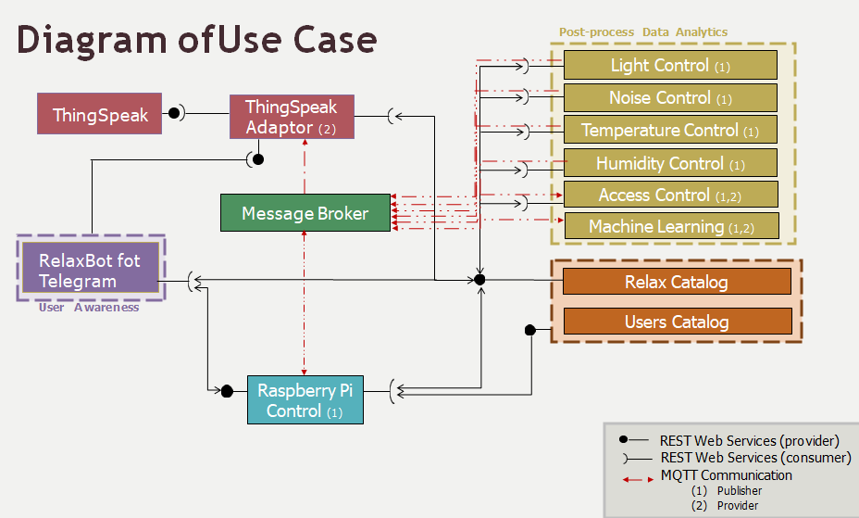
PROJECT PROPOSAL - AFTER

Slide 7
MICROSERVICES APPROACH
THINGSPEAK
CATALOGS
Architectural model for software development where an application is composed of small independent services, each handling a specific process. These microservices are designed to be modular, scalable, and independently distributable.
This approach promotes flexibility and ease of maintenance, allowing developers to update, replace, or scale individual services without having to modify the entire application.
TELEGRAM
SENSORS

Slide 8
MICROSERVICES APPROACH
THINGSPEAK
CATALOGS
TELEGRAM
SENSORS

Slide 9
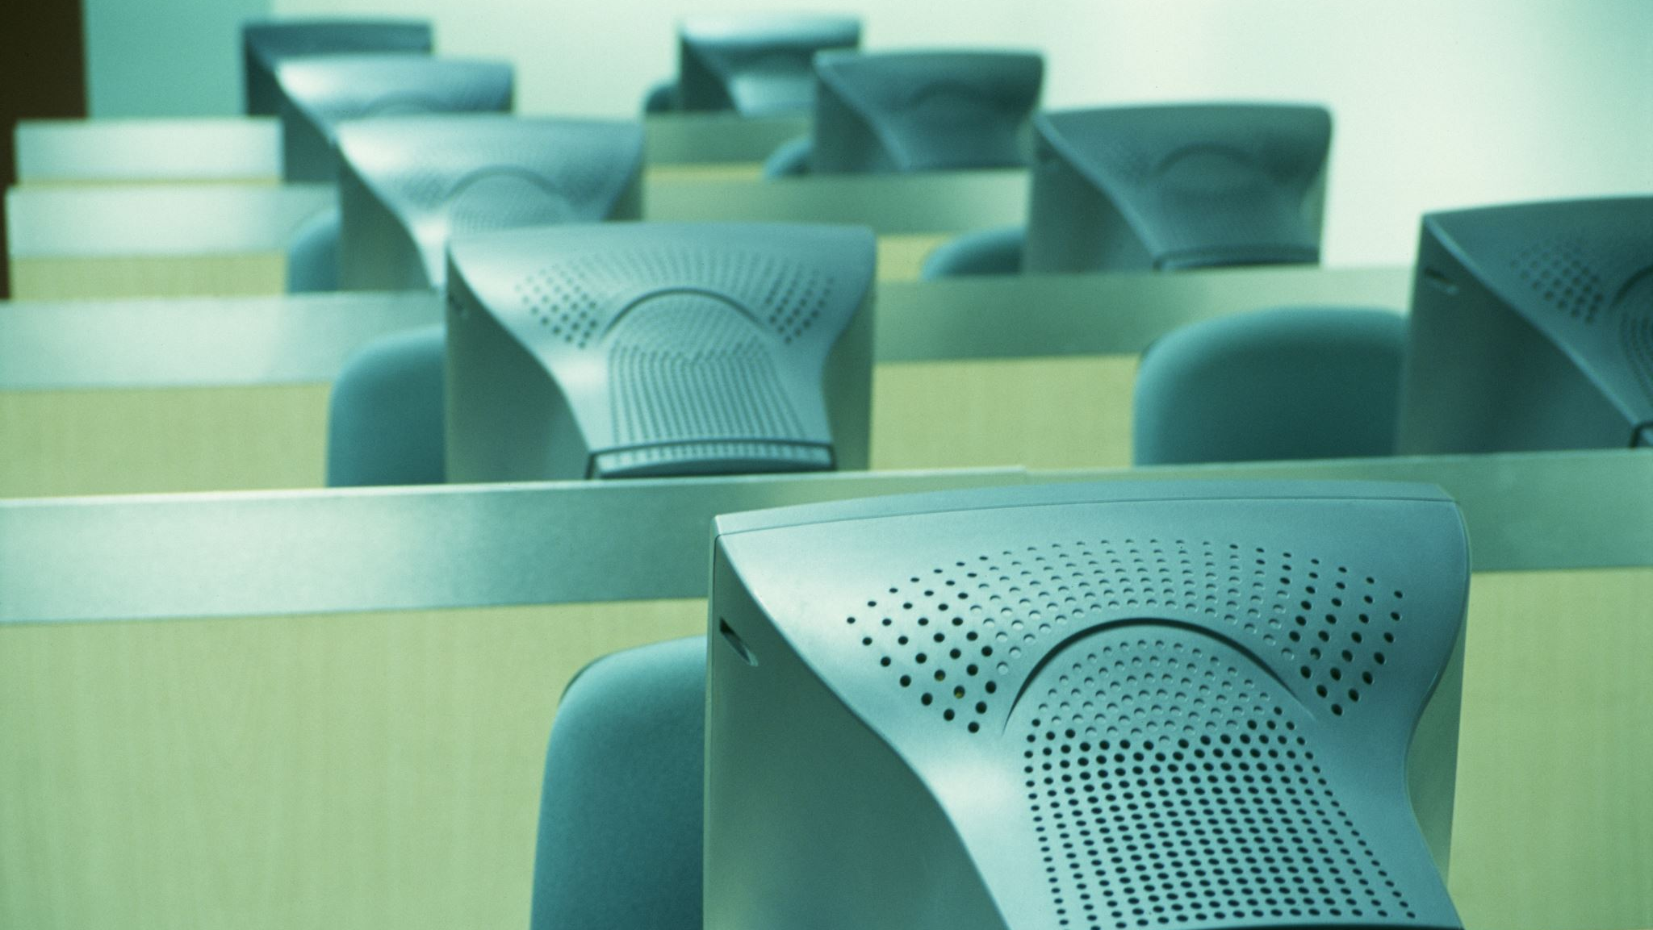
SERVICE CATALOG
SERVICE REGISTRY SYSTEM
SERVICE CATALOG SETTINGS PROVIDES THE INFORMATION NECESSARY FOR COMMUNICATION VIA REST
THE SYNCHRONOUS COMMUNICATION IS BASED ON JSON FILE FORMAT
FUNCTIONS ARE IMPLEMENTED THROUGH THE CHERRYPY AND REQUESTS PYTHON LIBRARIES

Slide 10
SERVICE CATALOG
USED TO DISCOVER REGISTERED SERVICES IN THE NETWORK
CONTAINS THE ROOMS OF EACH OWNER
INTERACTS WITH:
- RESOURCE CATALOG
- DEVICE CONNECTOR
- APPLICATIONS

Slide 11
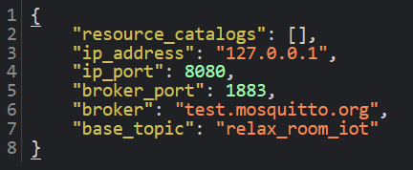
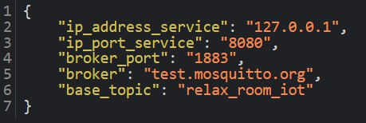
SERVICE_CATALOG_SETTINGS.JSON
SET UP PHASE
SERVICE CATALOG
ACT AS:
REST server
SERVICE_CATALOG_INFO.JSON

Slide 12
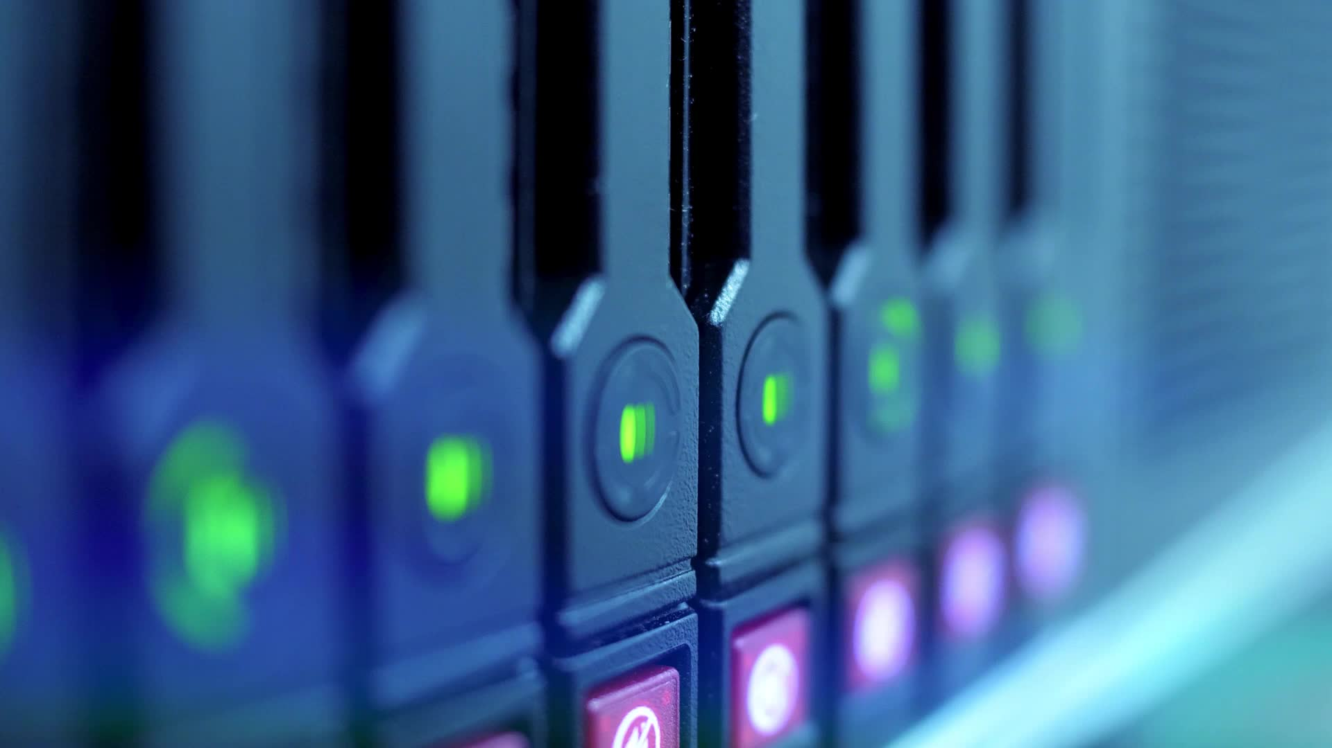
RESOURCE CATALOG
DEVICE REGISTRY SYSTEM
RESOURCE CATALOG SETTINGS PROVIDES THE INFORMATION NECESSARY FOR COMMUNICATION VIA REST
EACH RESOURCE CATALOG ACTS BOTH AS REST SERVER AND AS REST CLIENT

Slide 13
RESOURCE CATALOG
USED TO REGISTER AND PROVIDE AVAILABLE IoT DEVICES IN THE NETWORK
CONTAINS THE DEVICES IN EACH ROOM
INTERACTS WITH :
- SERVICE CATALOG
- DEVICE CONNECTOR
- APPLICATIONS

Slide 14
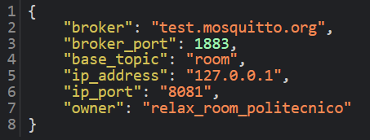
SET UP PHASE
Resource catalog registration
RESOURCE_CATALOG_SETTINGS.JSON
RESOURCE CATALOG
ACT AS:
REST server
REST client

Slide 15
Resource catalog registration
SERVICE CATALOG
ACT AS:
REST server
POST/PUT
RESOURCE CATALOG
ACT AS:
REST server
REST client

Slide 16
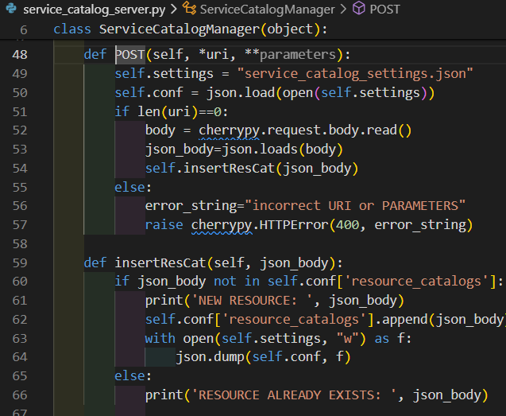
RESOURCE CATALOG SERVER
POST request
SERVICE CATALOG SERVER
POST

Slide 17
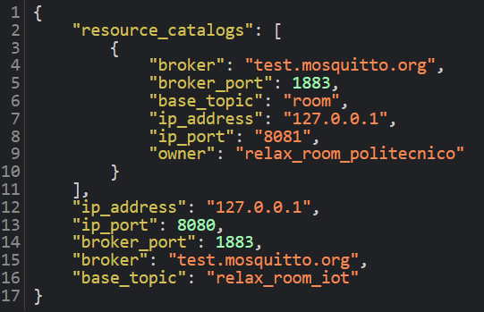
SERVICE_CATALOG_SETTINGS.JSON
SERVICE_CATALOG_SETTINGS.JSON
NEW RESOURCE

Slide 18
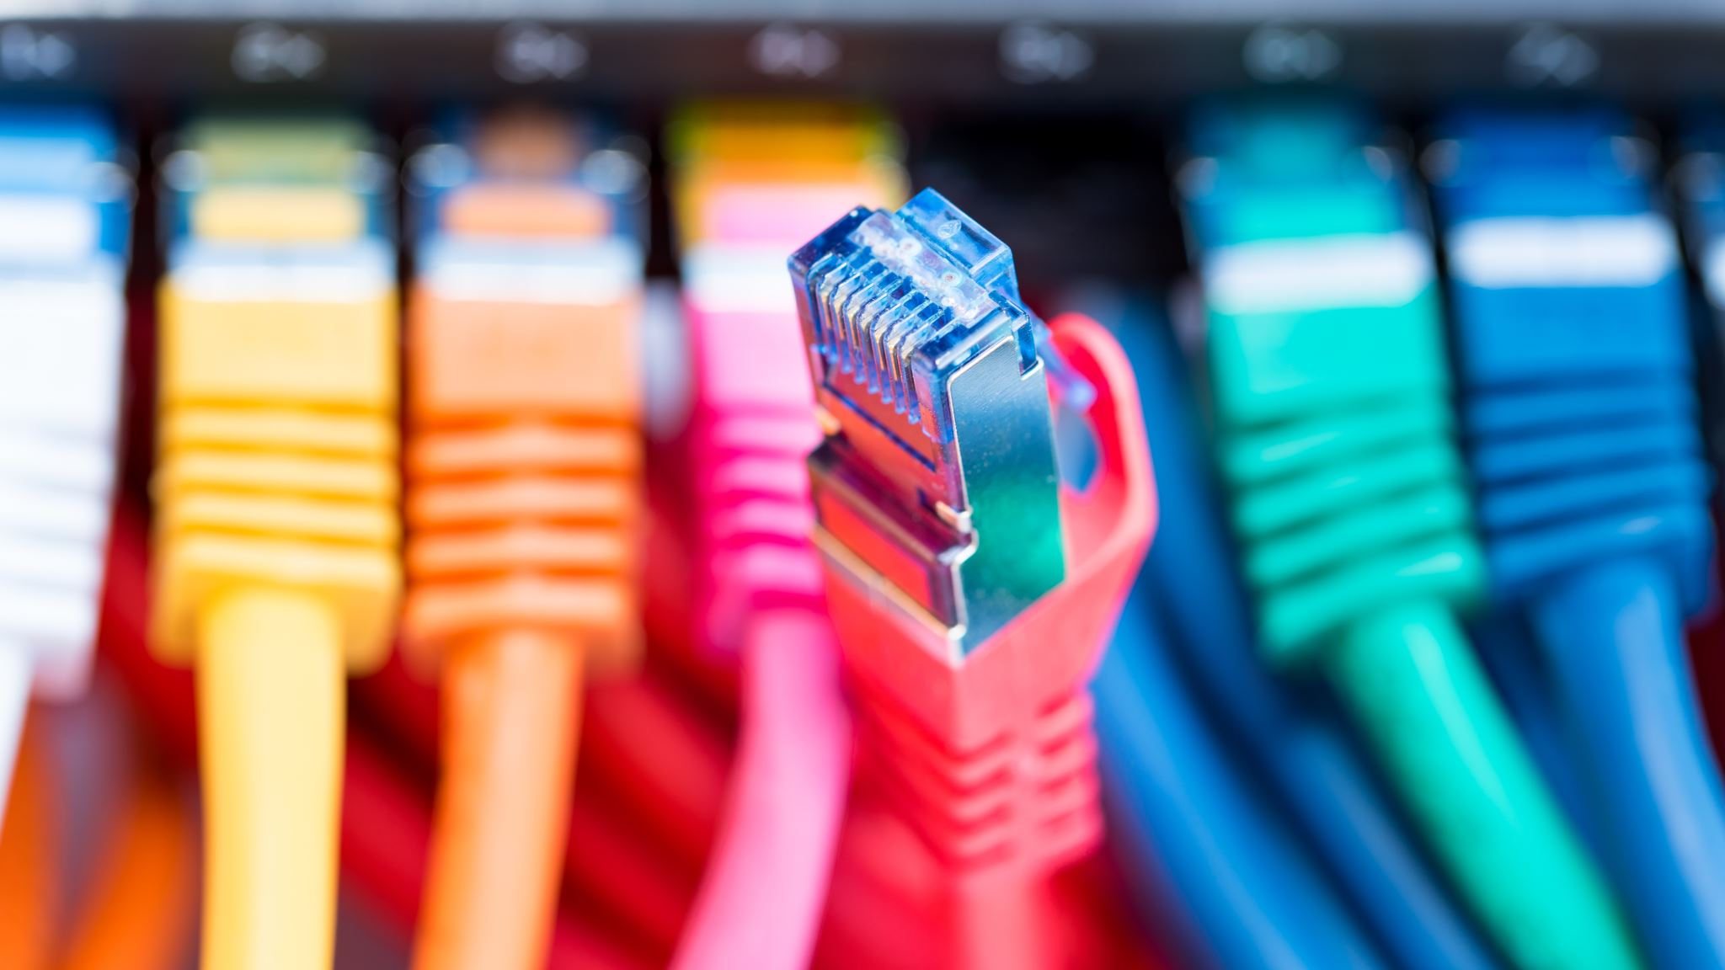
DEVICE CONNECTOR
PROVIDES THE INTEGRATION OF VARIOUS IoT DEVICES
MANAGES DEVICES AND THEIR RESOURCES IN THE RESOURCE CATALOG

Slide 19
MICROSERVICES APPROACH
THINGSPEAK
CATALOGS
TELEGRAM
SENSORS

Slide 20

SENSORS
REGISTRATION PHASE:
RETRIEVE INFORMATION ABOUT LIST OF RESOURCE CATALOGS FROM SERVICE CATALOG
RETRIEVE INFORMATION OF THE SPECIFIC RESOURCE CATALOG
REGISTRATION TO RESOURCE CATALOG
SenML DATAFORMAT
EACH SENSOR HAS A CONFIGURATION FILE

Slide 21
Sensor/actuator request to service catalog for list of resource catalogs
SERVICE CATALOG
ACT AS:
REST server
GET
RESOURCE CATALOG
ACT AS:
REST server
REST client
SENSOR
(temperature)
ACT AS:
REST client
MQTT publisher
SENSOR
(humidity)
ACT AS:
REST client
MQTT publisher
SENSOR
(light)
ACT AS:
REST client
MQTT publisher
SENSOR
(noise)
ACT AS:
REST client
MQTT publisher
SENSOR
(evo)
ACT AS:
REST client
MQTT publisher
MQTT subscriber

Slide 22
Service catalog response
SERVICE CATALOG
ACT AS:
REST server
RESOURCE CATALOG
ACT AS:
REST server
REST client
SENSOR
(temperature)
ACT AS:
REST client
MQTT publisher
SENSOR
(humidity)
ACT AS:
REST client
MQTT publisher
SENSOR
(light)
ACT AS:
REST client
MQTT publisher
SENSOR
(noise)
ACT AS:
REST client
MQTT publisher
SENSOR
(evo)
ACT AS:
REST client
MQTT publisher
MQTT subscriber

Slide 23
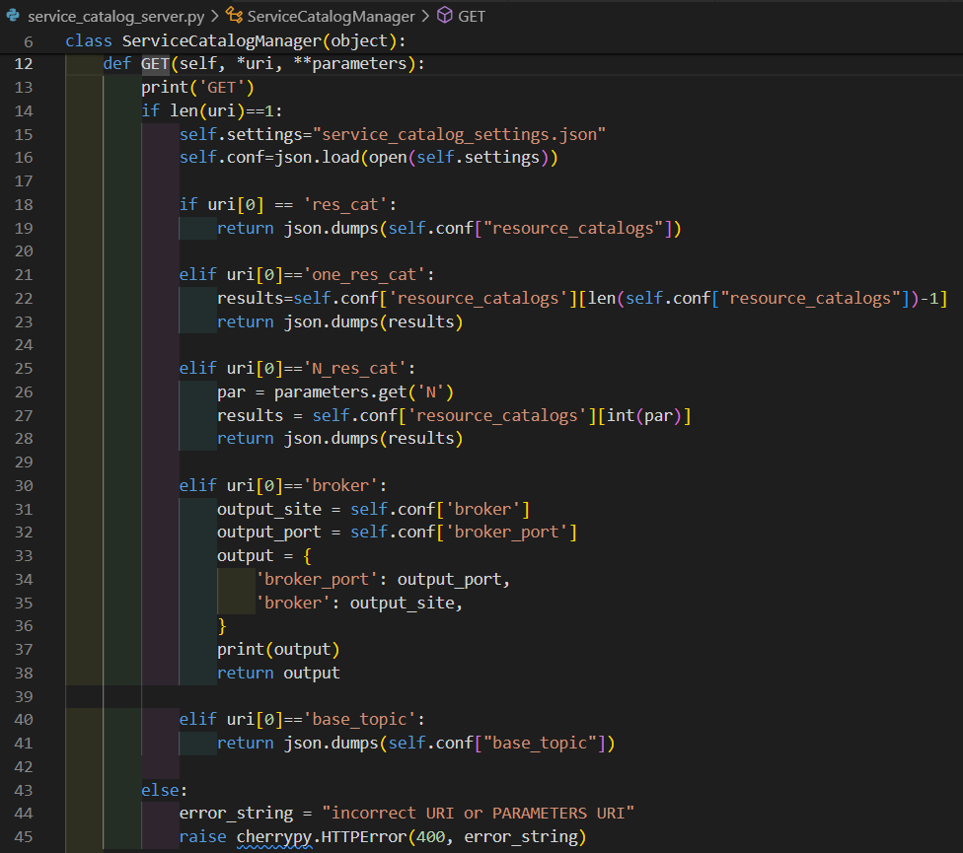
SENSORS
GET requests
SERVICE CATALOG SERVER
GET

Slide 24
Sensor request to service catalog for the particular resource catalog’s info
SERVICE CATALOG
ACT AS:
REST server
GET
RESOURCE CATALOG
ACT AS:
REST server
REST client
SENSOR
(temperature)
ACT AS:
REST client
MQTT publisher
SENSOR
(humidity)
ACT AS:
REST client
MQTT publisher
SENSOR
(light)
ACT AS:
REST client
MQTT publisher
SENSOR
(noise)
ACT AS:
REST client
MQTT publisher
SENSOR
(evo)
ACT AS:
REST client
MQTT publisher
MQTT subscriber

Slide 25
Service catalog response
SERVICE CATALOG
ACT AS:
REST server
RESOURCE CATALOG
ACT AS:
REST server
REST client
SENSOR
(temperature)
ACT AS:
REST client
MQTT publisher
SENSOR
(humidity)
ACT AS:
REST client
MQTT publisher
SENSOR
(light)
ACT AS:
REST client
MQTT publisher
SENSOR
(noise)
ACT AS:
REST client
MQTT publisher
SENSOR
(evo)
ACT AS:
REST client
MQTT publisher
MQTT subscriber

Slide 26
SENSORS
GET requests
SERVICE CATALOG SERVER
GET

Slide 27
Sensor/actuator registration in resource catalog
SERVICE CATALOG
ACT AS:
REST server
RESOURCE CATALOG
ACT AS:
REST server
REST client
POST
SENSOR
(temperature)
ACT AS:
REST client
MQTT publisher
SENSOR
(humidity)
ACT AS:
REST client
MQTT publisher
SENSOR
(light)
ACT AS:
REST client
MQTT publisher
SENSOR
(noise)
ACT AS:
REST client
MQTT publisher
SENSOR
(evo)
ACT AS:
REST client
MQTT publisher
MQTT subscriber

Slide 28
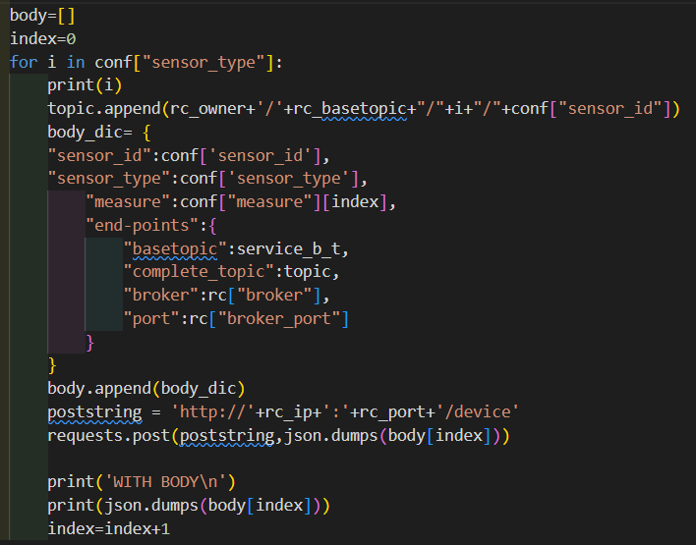
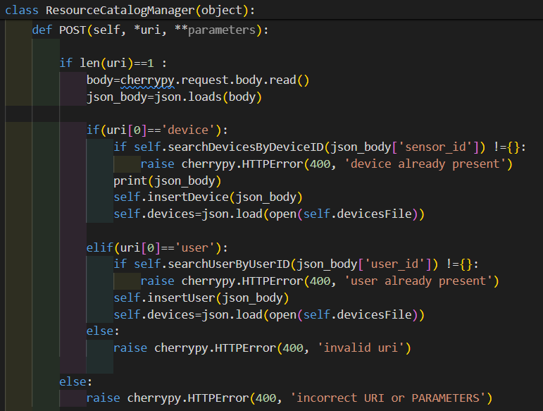
SENSORS
POST requests
RESOURCE CATALOG SERVER
POST

Slide 29
SENSORS
BRIGHTNESS
NOISE
ACCESS
TEMPERATURE
HUMIDITY

Slide 30
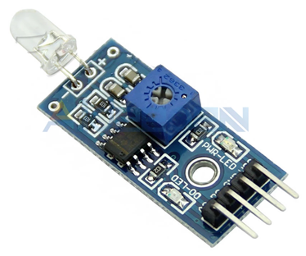
BRIGHTNESS
MONITORS AND CONTROLS BRIGHTNESS OF THE ROOM
REGISTERED ON RESOURCE CATALOG
SENDS INFORMATION VIA MQTT
TOPIC:
relax_room_XXX/room/brightness
DISPLAY A MESSAGE IF VALUE OVERCOMES A PREDEFINED THRESHOLD
PROVIDES DATA TO TELEGRAM AND THINGSPEAK

Slide 31
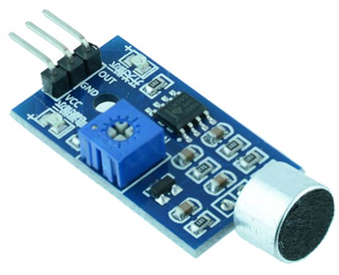
NOISE
MONITORS AND CONTROLS NOISE IN THE ROOM
REGISTERED ON RESOURCE CATALOG
SENDS INFORMATION VIA MQTT
TOPIC:
study_room_XXX /room/noise
PROVIDES DATA TO MACHINE LEARNING THROUGH MQTT
DISPLAY A MESSAGE IF VALUE OVERCOMES A PREDEFINED THRESHOLD
PROVIDES DATA TO TELEGRAM AND THINGSPEAK

Slide 32
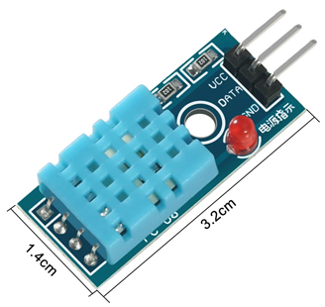
TEMPERATURE and HUMIDITY
MONITORS TEMPERATURE AND HUMIDITY IN THE ROOM
TOPIC:
study_room_XXX/room/temperature
study_room_XXX /room_1/humidity
PROVIDES DATA TO MACHINE LEARNING THROUGH MQTT
DISPLAY A MESSAGE IF VALUE OVERCOMES A PREDEFINED THRESHOLD
PROVIDES DATA TO TELEGRAM AND THINGSPEAK

Slide 33
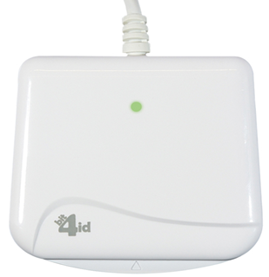
ACCESS
MONITORS AND CONTROLS THE ACCESS TO THE ROOM
REGISTERED ON RESOURCE CATALOG
TOPIC:
relax_room_XXX/room/fiscal_code
EVALUATES ACCESS BASED ON LIST OF AUTHORIZED USERS IN RESOURCE_CATALOG_USERS
PRINTS MESSAGE ON LCD SCREEN

Slide 34
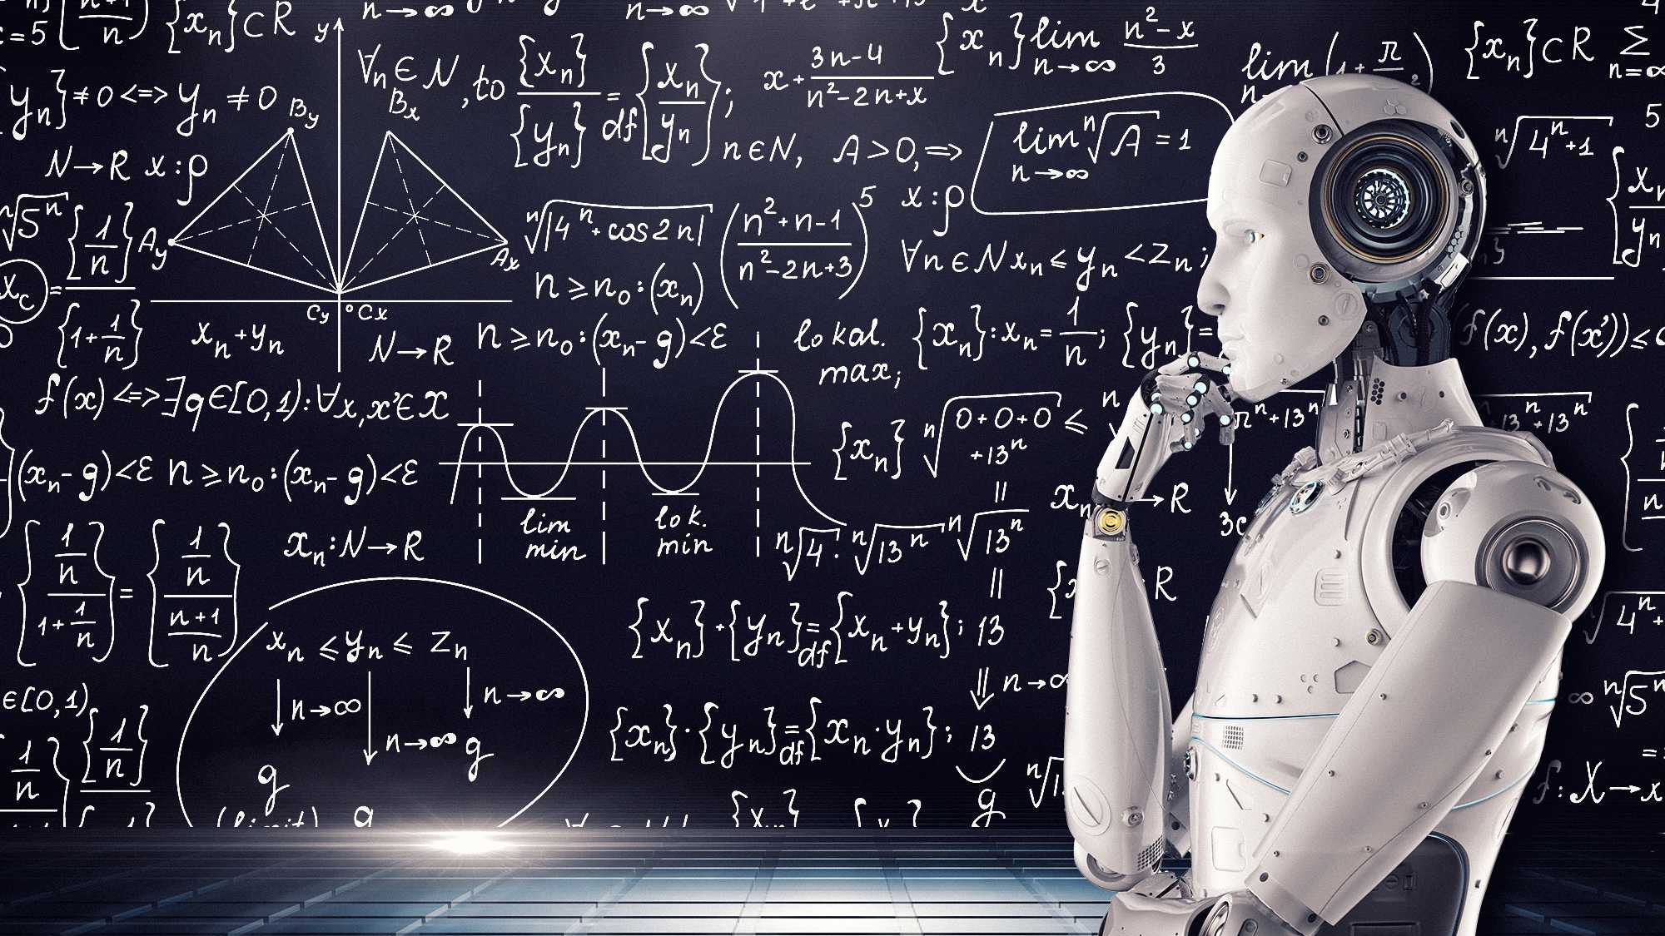
MACHINE LEARNING

Slide 35
Machine Learning model
Split the data into training and testing sets to evaluate the model's performance.
Use a decision tree classifier (random forest) for its simplicity and interpretability.
The model is trained on the training set.
Manage the number of people allowed to enter the room using a machine learning model
Data from sensors are received throught MQTT communication:
It considers data about:
Number of people inside
Temperature
Humidity
The prediction results about safe occupancy are published to a specific MQTT topic (relax_room_XXX/room/safe_occupancy).

Slide 36
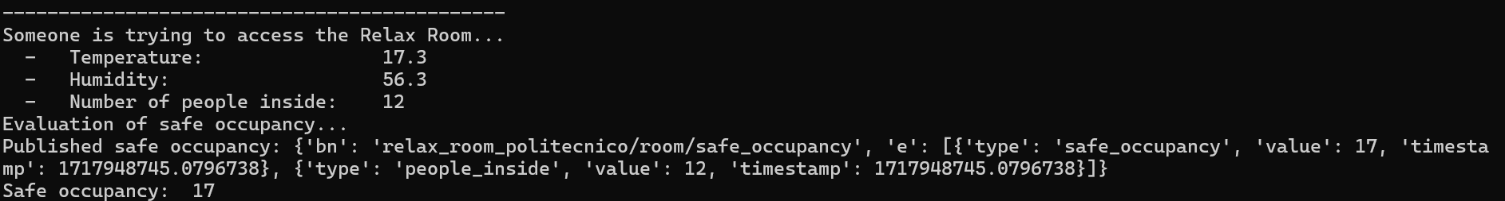
TEMPERATURE
Temperature value
HUMIDITY
MACHINE LEARNING
Humidity value
MQTT communication
ACCESS
People inside

Slide 37
MACHINE LEARNING
MQTT communication
ACCESS
Safe occupancy

Slide 38
MACHINE LEARNING
People already inside
Number of people that can enter the Relax Room
Safe occupancy (evaluated by Machine Learning)
Maximum people allowed (Fixed number=25)

Slide 39
MICROSERVICES APPROACH
THINGSPEAK
CATALOGS
TELEGRAM
SENSORS

Slide 40
TELEGRAM BOT
PROVIDES DATA RELATED TO THE ENVIRONMENT
SENDS A GET REQUEST TO RECEIVE DATA FROM SENSORS
COMMUNICATES WITH THINGSPEAK IN ORDER TO RETRIEVE GRAPHICAL INFO
USED TO CREATE NEW RELAX ROOMS
PROVIDES A SCALABLE SERVICE ALLOWING THE CONTROL OFFICER TO CHOOSE:
THE OWNER
THE ROOM
THE SENSOR

Slide 41
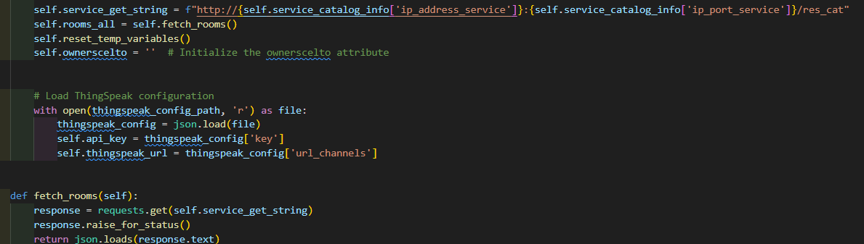
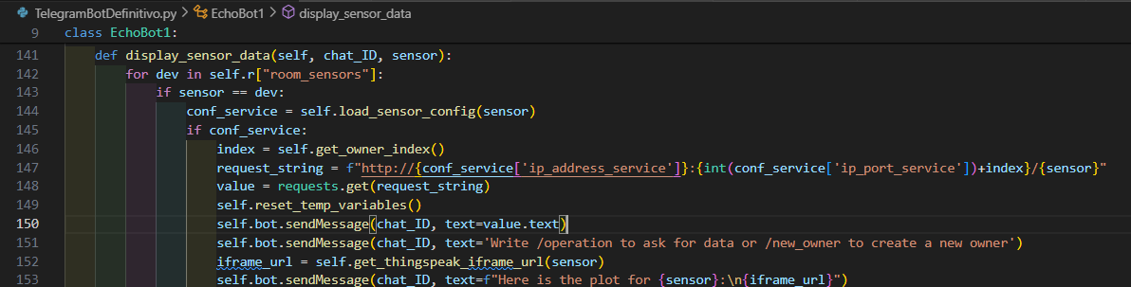
COMMUNICATION WITH:
SERVICE CATALOG TO RECEIVE INFORMATIONS ABOUT:
- OWNERS
- ROOMS
RESOURCE CATALOG TO RECEIVE INFORMATIONS ABOUT:
- DEVICES
DEVICE CONNECTOR TO RECEIVE INFORMATIONS ABOUT:
- SENSORS

Slide 42

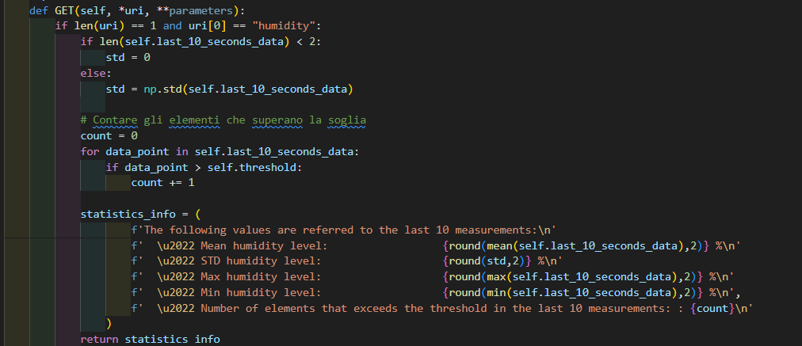
DEVICE CONNECTOR TO RECEIVE INFORMATIONS ABOUT:
- SENSORS
TELEGRAM BOT
GET requests
SENSORS
GET

Slide 43
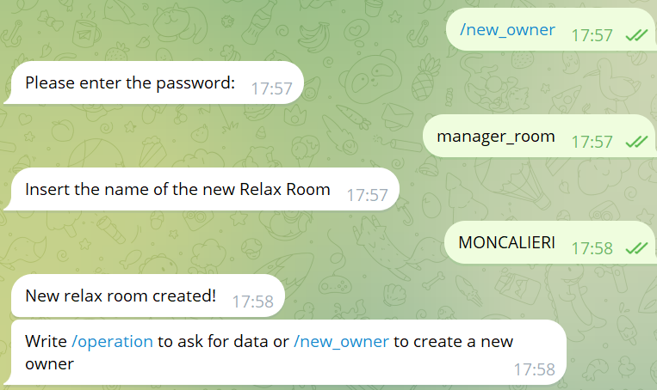
USED TO CREATE NEW RELAX ROOMS

Slide 44
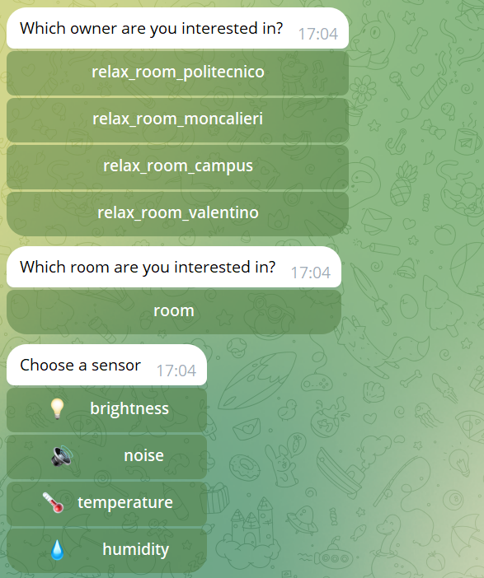
PROVIDES A SCALABLE SERVICE ALLOWING THE CONTROL OFFICER TO CHOOSE:
THE OWNER
THE ROOM
THE SENSOR

Slide 45
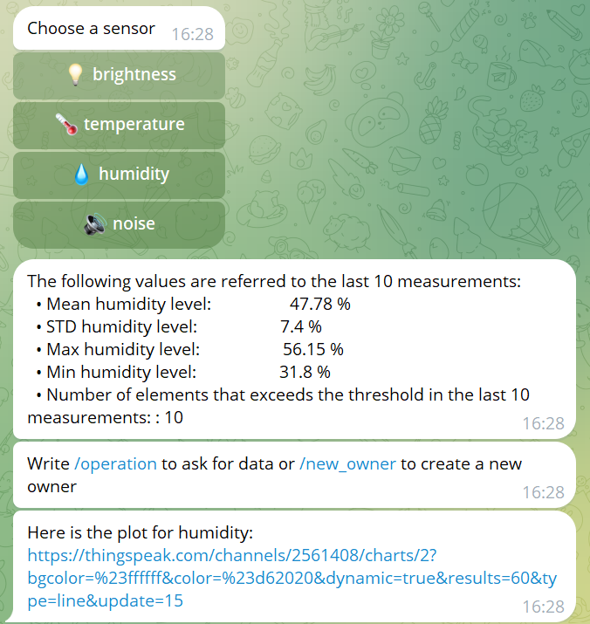
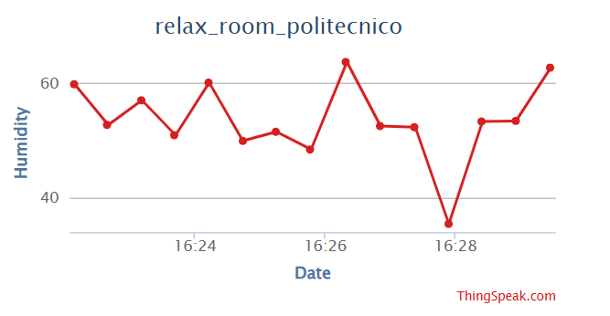
COMMUNICATION WITH:
THINGSPEAK
Provides graphic info through REST

Slide 46
MICROSERVICES APPROACH
THINGSPEAK
CATALOGS
TELEGRAM
SENSORS

Slide 47
THINGSPEAK
COLLECTS THE DATA SENT BY THE SENSORS
ALLOWS TO HAVE A GRAPHICAL INTERFACE CONTAINING THE TRENDS OF THE DATA PROVIDED IN REAL TIME
COMMUNICATES WITH TELEGRAM

Slide 48
THINGSPEAK ADAPTOR
ACT AS:
REST Client
REST Server
MQTT Subscriber
REST
REST
REST
MQTT
THINGSPEAK
SERVICE AND RESOURCE CATALOG
TELEGRAM
DEVICE CONNECTOR

Slide 49
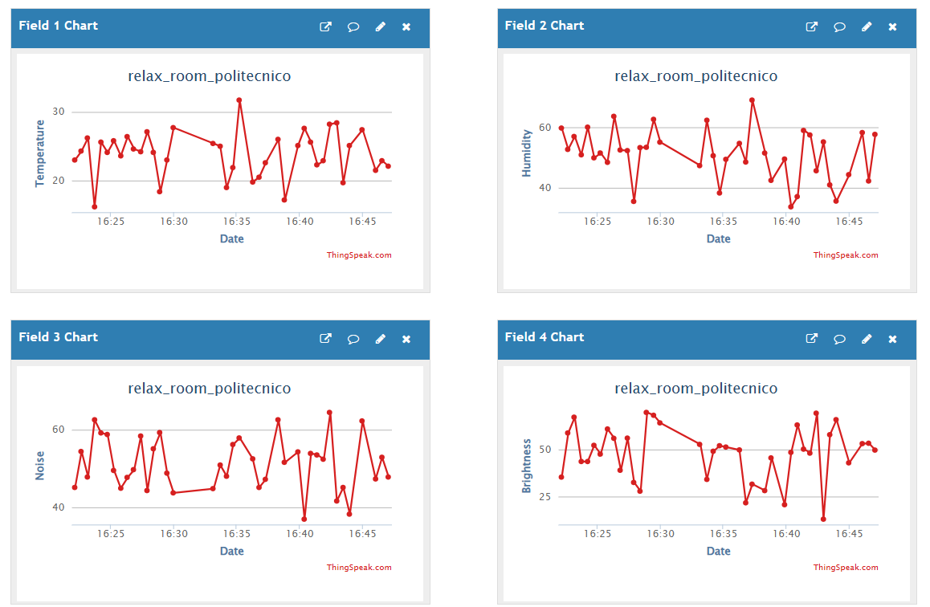
THINGSPEAK

Slide 50
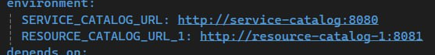
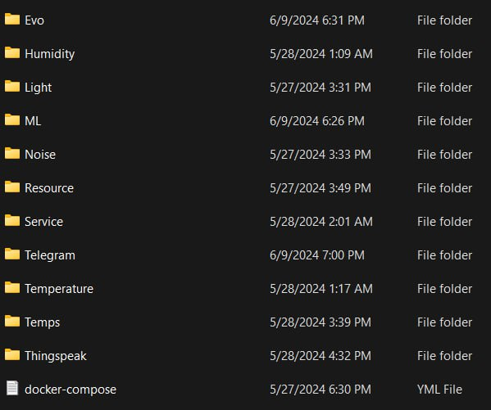
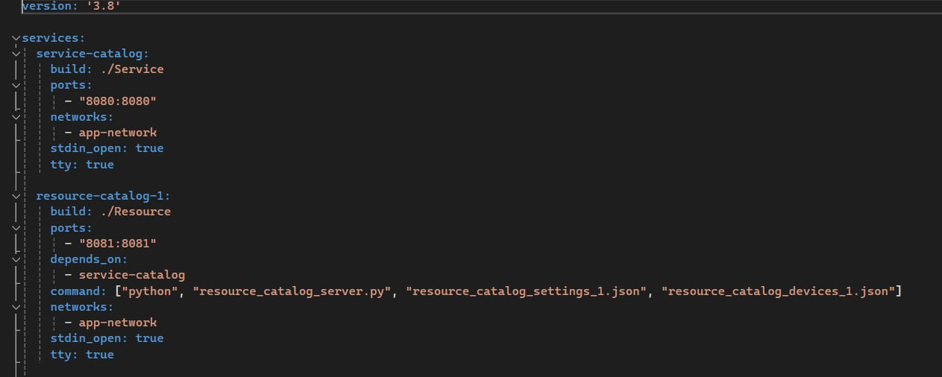
DOCKER

